Slide 1
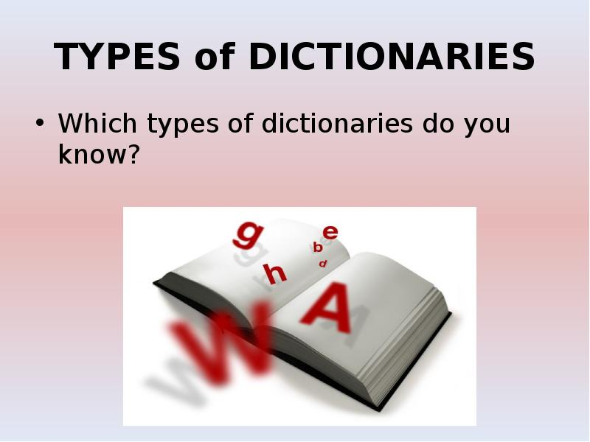

Slide 2
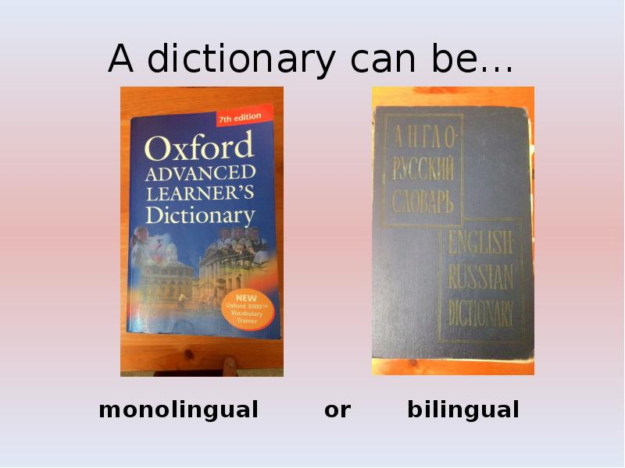

Slide 3
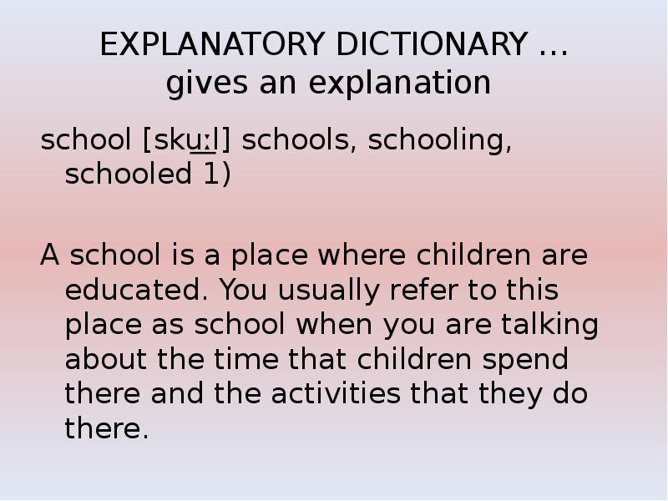

Slide 4
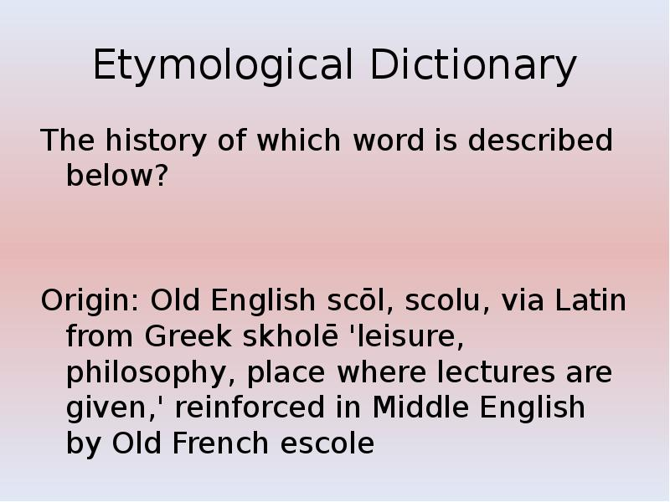

Slide 5
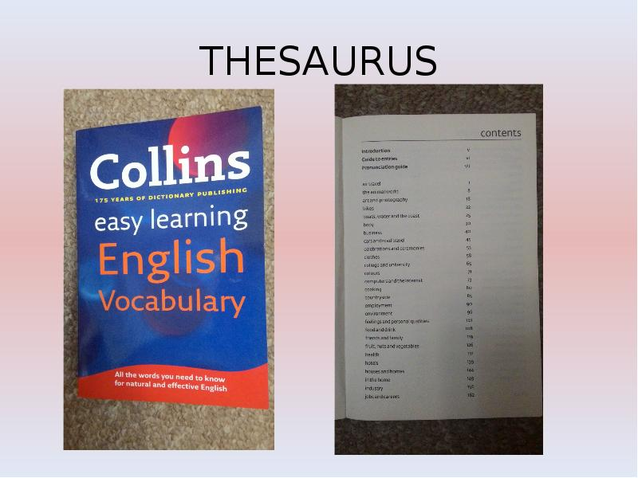

Slide 6
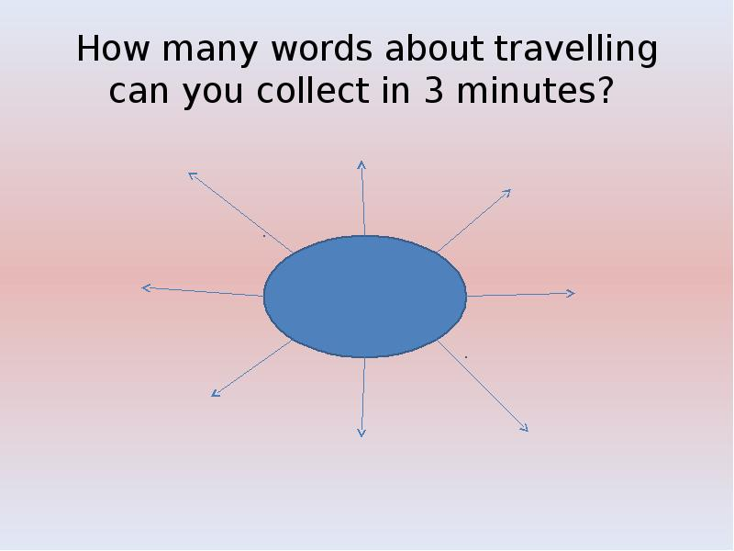

Slide 7
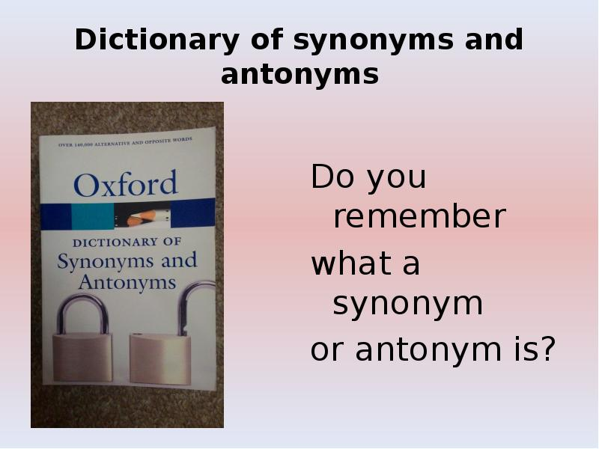

Slide 8
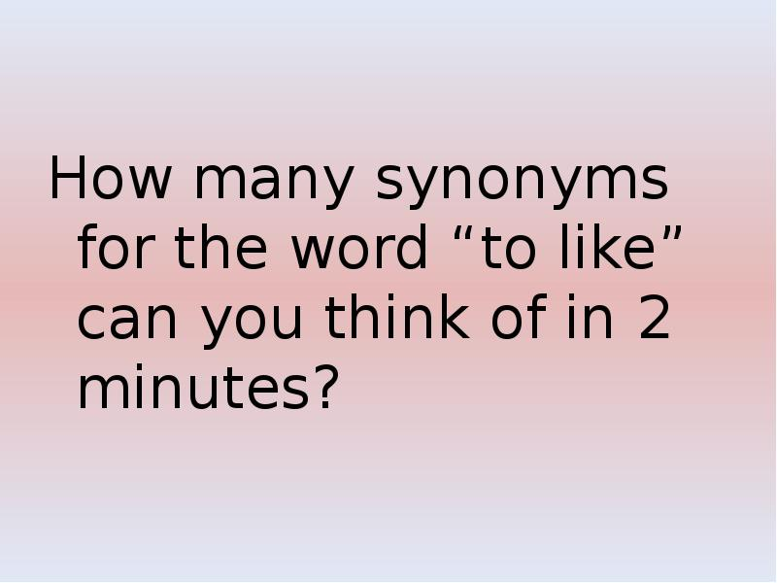

Slide 9
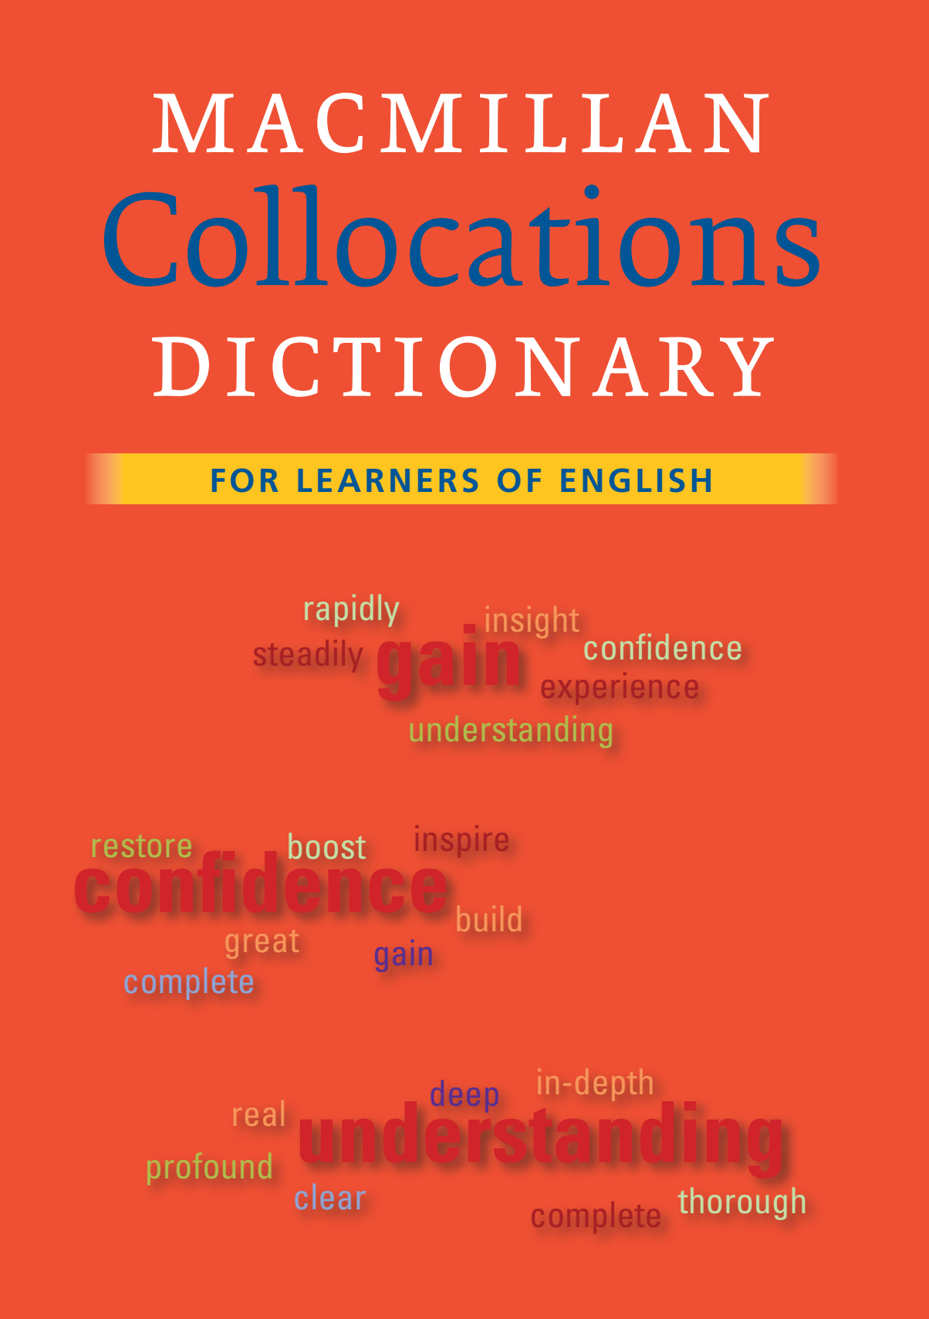
COLLOCATIONS DICTIONARIES
Collocation is a grouping of familiar words that seem to belong together
because of their continual use and thus creating a coherent meaning.
To make the bed / money / a noise
To catch a cold / a bus / a fish
To come late / on time / to a decision
To do homework / the shopping / nothing
To know more COLLOCATIONS you can use COLLOCATIONS DICITIONARIES
or follow the link https://www.learnenglishteam.com/useful-english-collocations/

Slide 10
Match the two parts of these collocations:
ADHERE | RAIN
AROUSE | DIFFERENT
BLOND | OF WISDOM
COME UP WITH | YOUR PRINCIPLES
FLATLY | AN ECONOMY DRIVE
FUNDAMENTALLY | A SEMINAR
GO ON | SOMEONE’S INTEREST
HEAVY | CONTRADICT
LEAD | HAIR
A LICK | THE STOCK MARKET
PLAY | OF PAINT
WORDS | A SUGGESTION

Slide 11

DICTIONARIES OF IDIOMS
Idioms are phrases or expressions that have a non-literal meaning, i.e.
their meaning cannot be understood by reading the individual words in them directly.
Go the extra mile – to do more than is expected of you
I’m a hard worker and always go the extra mile to make sure my team does well.
Pull one’s weight – to do a fair share of the work
There’s always one guy at work who doesn’t pull his weight.
Follow one’s heart – do what you feel is right for you
After university, I decided to follow my heart and become a doctor.
Raise one’s game – improve the standard of your work or performance
When I started working at Nike HQ, I really had to raise my game!
On the dole – receiving unemployment benefit from the state welfare system
When I was between jobs, I was on the dole for about 6 months.
To know more IDIOMS you can use IDIOMS DICTIONARIES
or follow the link https://onlineteachersuk.com/ielts-speaking-idioms/

Slide 12
Complete the sentences using idioms: a blessing in disguise, a drop in the ocean, a piece of cake, actions speak louder than words, an arm and a leg, chip on his shoulder, it's a small world, jumping the gun, once in a blue moon, over the moon
1. Getting my car fixed is going to cost me _____________ as the engine has completely blown, but I have no choice. I need it for work.
2. The flu I had a few weeks ago which prevented me from going on holiday with my friends was _______________. They had a terrible time. Everything went wrong and it cost them a lot of money.
3. I was in a café in Italy and amazingly I saw Paul from down the road in there. __________________________
4. Jan is finally getting a chance to go on her trip of a life time, a holiday to Australia! She was ___________ when I spoke to her.
5. 3 pounds may seem like ___________________________ but if everyone contributed that much we'd have thousands.
6. The government keeps talking about reducing poverty but what do they ever do about it? Nothing! __________________________.
7. I've got a promotion at work, but all John did was make a joke about it. He has a real ______________________. I think he is just jealous.
8. The interview for that new job was ____________________. They asked me really easy questions.
9. The new Martin Scorsese film is out at the cinema. A film that comes out that I really enjoy and want to see happens ______________________, so I'll definitely go and see it.
10. He was ______________________when he gave up his job to start university. Now he has found out he can't get a grant.

Slide 13

DICTIONARIES OF PHRASAL VERBS
A phrasal verb is the combination of two or three words such as adverbs, propositions, or verbs which can act as a new word altogether. The meaning of the phrasal verb is completely different from the main or the original verb.
To know more PHRASAL VERBS you can use PHRASAL VERBS DICTIONARIES
or follow the link https://entri.app/blog/most-commonly-used-phrasal-verbs-in-english/
Call on | Invite someone formally to an event
Get by | To be able to live through a difficult situation
Hurry up | be quick
Get away | To escape
Call off | Cancel some plans
Back down | Withdraw

Slide 14
Use the phrasal verbs below in the blanks correctly: passed away, do without, look forward to, called off, made up, carried away, break out, run out, put up with, and keep up.
1. Don’t smoke in the forest. Fires……………………………………….. easily at this time of the year.
2. I…………………………………………… seeing my friends again.
3. I’m afraid; we have……………………………………………… of apple juice.
4. Your website has helped me a lot to……………………………………. phrasal verbs exercises.
5. A friend of mine has……………………………………… her wedding.
6. His mother can’t…………………………………… his terrible behavior anymore.
7. As an excuse for being late, she………………………………………a whole story.
8. I got……………………………………………. by his enthusiasm.
9. I just can not………………………………………. my mobile. I always keep it with me.
10. She was very sad because of her father………………………………………last week.

Slide 15


